Slide 1
Everything you wanted to know about Independent Fee Estimates (IFEs)
Notes:
Kelly – explain our format, try to keep it interesting with Q&A, talk show style

Slide 2
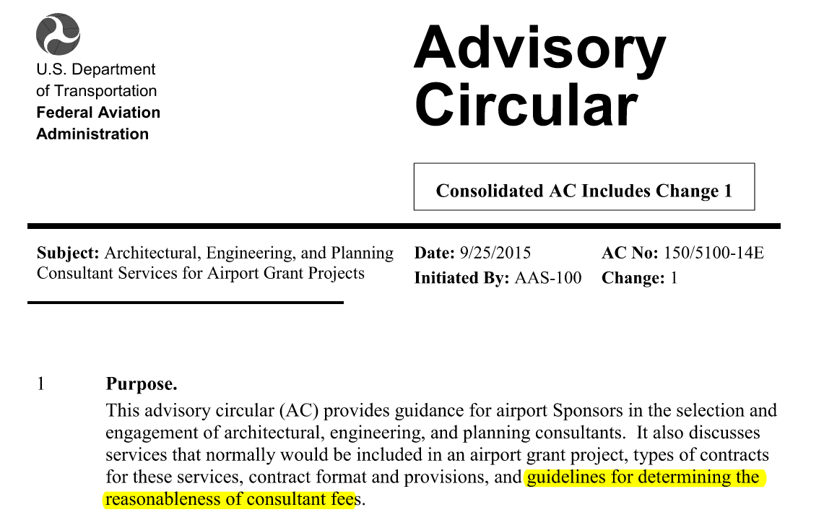
FAA AC 150/5100-14E
Notes:
Kelly – note we are using a couple of different resources/documents for this information and process

Slide 3
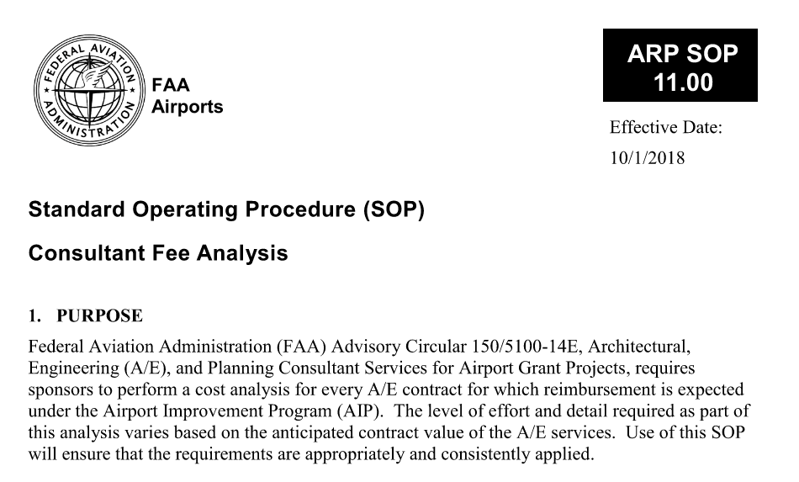
FAA SOP 11 – Consultant Fee Analysis
Notes:
Kelly – note we are using a couple of different resources/documents for this information and process
Don’t forget to include the ‘why’ – Sponsors are required to perform a cost analysis for every A/E contract for which reimbursement is expected under the AIP.
Construction is low bid based.

Slide 4
Old Process
Notes:
Kelly – Some people may be wondering what happened to the old process, Elyse can you talk a little about the process sponsors may have gotten used to?
MDOT provided a good service to airports for many years. This changed when FAA gave additional guidance and expectations

Slide 5
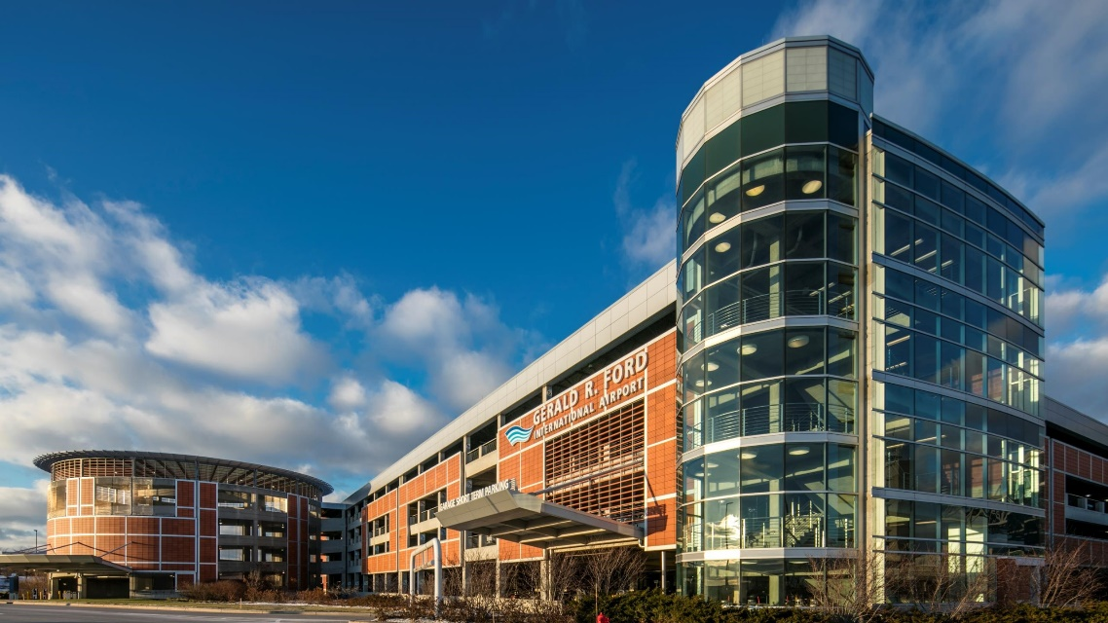
IFE Current Process
Sponsors must perform a cost analysis for any A/E contract under AIP
Level of detail varies
Anticipated value less than $100,000 = comparative analysis
Anticipated value more than $100,000 = detailed cost analysis
MDOT capabilities – dependent on capacity
IFEs for primary airports (detailed analysis)
Cost comparison for GA airports
Comparison to other states
Has the right to say the cost is not reasonable
Informal selection process ok for IFE consultant
GRR example
Notes:
Kelly start out with level of detail required. For detailed analysis must address direct labor work hours, labor rates, overhead, non-salary expenses and profit.
Elyse what support is MDOT able to offer sponsors now? Casey can you walk us through your internal process for IFEs when you have a new contract? How do you decide who will do it? How do you pay for it? Elyse if MDOT cannot perform the IFE and sponsors need support, who can they go to? (MDOT has a list) What is the process for choosing a consultant to do an IFE?

Slide 6
Design Procurement/Process Schedule
Capital Development Project Planned & Funding Identified
MAP/Planning meeting – MDOT/FAA decision on if IFE is needed
Grant Pre-Application (timing is project dependent)
Qualification based Selection Process
Request for Proposals
Short List/Interviews
Scoping
Independent Fee Estimate
Fee from Selected Consultant
Fee Review and Resolution
Contracting
Grant Final Application
Notes:
?? I’m not sure of the current answer from our ADO to: Do we know what MUST be included in the final grant application? Does the IFE need to be COMPLETE before final application? YES – also needed before transfer of funding through state.
Can speak to IFE for construction phase services as well

Slide 7
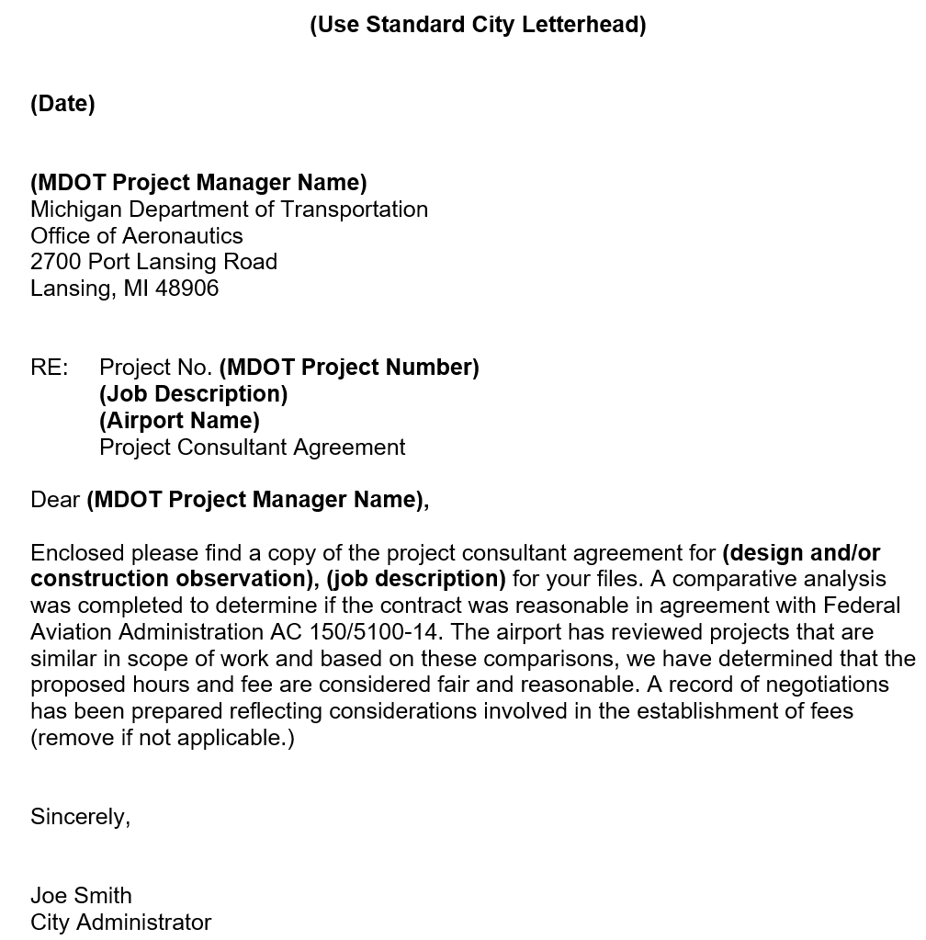
IFE Current Process
Deliverables
Scope of services
Draft contract with fee breakdown
Cost comparison documentation or detailed analysis
Record of negotiation
Letter of cost reasonableness
General review standard = within 10%
Negotiations needed if not within this range or considered unreasonable
Make sure scope of work is clear and inclusive of all tasks
Notes:
Elyse what are the documents that will need to be submitted to MDOT or FAA for review?
Casey what are you looking for when comparing contracts to the IFE?

Slide 8
Cost and Payment
IFEs are eligible for AIP funding
Cost varies dependent on scope of work and complexity
Payment up front
Differences with discretionary funding
Cannot incur costs prior to the grant
Include amount in MDOT sponsor contract and FAA grants
Notes:
Kelly – AIP eligible, costs vary (approx $2,500 - $7,500 but depends on work)
Elyse – Can you talk about how sponsors pay for IFEs? What is different about discretionary funding and how to make sure they get that cost included in their grants and sponsor contracts?

Slide 9
Items to Note
Important to the FAA – need consistency (SOP)
A detailed scope is important
Don’t forget subs or expenses
Timing is critical
Short listed consultants cannot perform the IFE
Utilize sample letters from FAA or MDOT
Talk to your MDOT project manager for help
Notes:
Casey – 2
Kelly – 2
Elyse – 3

Slide 10
Questions
&
Answers
Kelly Jost – kjost@cscos.com
Casey Ries – cries@grr.org
Elyse Lower – LowerE1@michigan.gov

Slide 11
Presenters
Casey Ries
Gerald R. Ford International Airport
Kelly Jost
C&S Engineers
Elyse Lower
MDOT Office of Aeronautics

