Slide 1
Advanced Air Mobility (AAM) & Vertiports Update
Rebecca MacPherson
February 2022

Slide 2
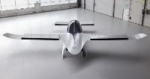
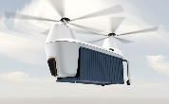
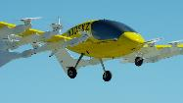
Advanced Air Mobility (AAM) Integration
The FAA’s current regulatory framework will support industry’s efforts to achieve near-term operations
Baseline and Context for Conversations
The FAA envisions an aviation transportation system that will use highly automated aircraft to transport passengers or cargo for hire.
AAM is not a single technology, but rather a collection of new and emerging technologies being applied to the existing aviation system, particularly in new aircraft types.
Notional Use Cases Include:
Urban Air Mobility
(intra-city)
Regional Air Mobility
(inter-city)
Public Services
(fire, air ambulance, search & rescue)
Cargo Delivery
(large aircraft)
Private & Recreational Vehicles

Slide 3
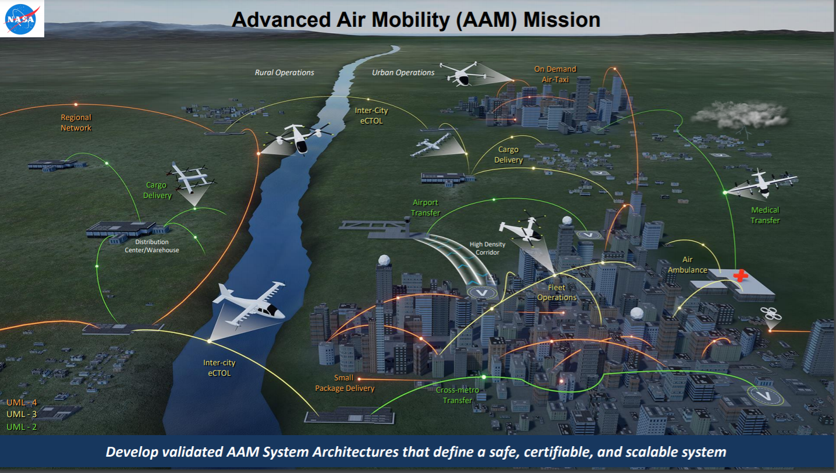
AAM Use Cases
Source: NASA.gov

Slide 4
What Do We Expect to See Initially?
Majority of concepts:
  Multi-rotor and fixed wing aircraft capable of vertical takeoff and landing;
  Will be crewed/manned operating under existing regulatory framework;
  Have a mix of 3-8 passenger seats;
  Will primarily use existing infrastructure; and
  Electrically powered with various levels of aircraft automation.
U.S. FAA type certification of first aircraft anticipated in 2024.
Initial infrastructure will focus on demonstration/testing of leading aircraft.
Likely that a few cities will create demonstration vertiports/networks.

Slide 5

What Does Maturity Look Like?
Highly Automated Aircraft and Ground Infrastructure.
Simplified Vehicle Operations (SVO) or Uncrewed.
High Density Vertiports.
Mesh of Smart Transportation Networks.
Source: NASA.gov

Slide 6

The FAA’s Five Areas of AAM
Five areas guiding the FAA’s AAM work: aircraft, airspace, operations, infrastructure, and community
Aircraft
Airspace
Operations
Infrastructure
Community
Several aircraft manufacturers currently in the FAA’s Type Certification process
FAA’s Center for Emerging Concepts and Innovation (CECI) facilitates pre-application engagement (PAE) with industry applicants
Initial AAM operations will utilize existing Visual Flight Rules (VFR) procedures and low altitude VFR routes
The AAM aircraft characteristics and their equipage may require a combination of waivers and agreements with local facilities to enable initial operations
Current FAA Regulations (Part 135) are flexible enough to accommodate near term AAM operations.
FAA Flight Standards (AFS) is organizing their approach on industry proposals for future simplified vehicle operations (SVO)
14 CFR Part 157 contains notification requirements for new vertiport proposals.
FAA’s Office of Airports (ARP) is developing a new vertiport Advisory Circular (AC) for regulatory guidance on vertiport infrastructure. Interim guidance is expected in 2022
Early Engagement and Collaboration are critical to success
Near-term AAM operations will begin to set the stage for the widespread community awareness, and understanding/addressing community feedback
Environmental Review

Slide 7
Vertiport Advisory Circular
FAA Advisory Circular (AC) 150/5390-3, Vertiport Design, cancelled in 2010 due to lack of compatible aircraft.
Need standards to address facilities required for the boarding and discharging of passengers and cargo by vertical/short take-off and landing (VTOL/STOL) aircraft.
Future standards needs to be performance based.
  These facilities may have a variety of configurations depending on the level of throughput that is expected at that facility and the characteristics of the aircraft they plan to support.

Slide 8
Vertiport Advisory Circular
The operational requirements of these facilities will include:
  Landing area design and layout/geometry
  Approach/departure paths
  Load bearing requirements
  Electric propulsion and charging stations
  Safety requirements for batteries and other hazardous materials
  Noise requirements
The dimensional requirements of the landing area will be based on the design characteristics and performance capabilities of VTOL aircraft.

Slide 9
Vertiport Research
FAA’s Airport Technology R&D Branch leading vertiport research.
  Posted a Request for Information (RFI) in 2019 seeking information from industry regarding VTOL aircraft design and specifications, concepts of operations, infrastructure design, and takeoff and landing profile.
    Received only 9 partial responses.
  Industry initially reluctant to share data due to Intellectual Property (IP) concerns.

Slide 10
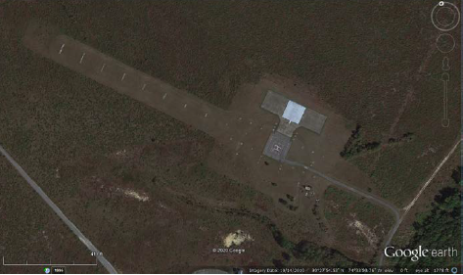
Vertiport Research
Investigate VTOL aircraft technologies and determine the maturity of each technology.
Evaluate the performance and characteristics of VTOL aircraft to help develop design standards and guidance.
Research will focus on VTOL aircraft less than 7000 lbs and carry fewer than 9 passengers. Larger VTOL and STOL aircraft will be considered, but not the focus.
Research steps include:
  Literature review and gap analysis;
  Conceptual Testing and Simulations; and
  Operational Testing.

Slide 11
Vertiport Research
Milestones Completed
  Literature review and gap analysis completed by research subcontractor.
  Partnered with FAA’s Aircraft Certification Service to facilitate introductions with Original Equipment Manufacturers (OEMs).
    Made contact with a dozen OEMs to discuss aircraft performance.
    Coordinated with FAA attorneys to determine how IP will be protected.
  Established regular communications with various industry associations, government partners, and leading cities to share information.

Slide 12
Vertiport Research
Sent two sets of inquires to OEMs to gather data needed for infrastructure considerations.
  Second inquiry focused on data needed for vertiport interim guidance.
  Additional inquiries may be made as research progresses.
Responses from the manufacturers have provided researchers a good idea of the maturity of each vehicle.
  OEMs committed to provide the FAA any missing data from the inquiries once they obtain through simulations or performance testing.

Slide 13
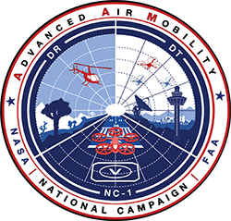
Vertiport Research
FAA is collaborating with NASA as part of NASA’s National Campaign and other AAM efforts.
  FAA personnel helped create a baseline design of a prototype vertiport used during flight evaluations.
  FAA is using NASA-led industry forums to bring aircraft manufacturers and stakeholders together to discuss key policy challenges.

Slide 14

Vertiport Research
FAA established an agreement with the National Renewable Energy Laboratory (NREL) to conduct an 18-month vertiport electrical infrastructure study.
Study will focus in various areas including:
  Vertiport charging needs
  Cybersecurity concerns
  Hazards evaluations

Slide 15
How are we addressing early adopters?
New vertiport AC won’t be completed until 2024/2025.
FAA will issue interim guidance (Engineering Brief) in 2022.
  The interim guidance will be prescriptive, not performance based like the future vertiport AC.
  Anticipate draft Engineering Brief available for public and industry comment within the next month.
Using existing processes under 14 CFR Parts 77 and 157 for notification and impact assessment of proposed vertiports and support infrastructure/equipment.

Slide 16
Engineering Brief
Defined as interim guidance for vertiport facilities based on the composite aircraft
  Anticipated use for existing infrastructure and greenfield vertiports
  Emphasis on safety critical areas
  Outline:
    Introduction
    Landing Area Design/Geometry
    Visual Aids/Lighting/Marking
    Charging/Electric (support from NREL)
    On-Airport Vertiports
    Site Safety Elements
Anticipated publish date: Summer 2022

Slide 17
Stakeholder Engagement: Advanced Aviation Advisory Committee
17
On October 27, 2021, the FAA announced the evolution of the Drone Advisory Committee (DAC) to the Advanced Aviation Advisory Committee (AAAC).
The AAAC is a broad-based federal advisory committee that provides independent advice and recommendations to the FAA on key unmanned aircraft system (UAS) and advanced air mobility (AAM) integration issues, interests and policies
Membership will expand from 35 to 41 members to add additional members from the AAM sector, a community advocate, and other stakeholder groups.
FAA published a notice in the Federal Register to solicit new applicants for AAAC membership. Nominations were due by January 10, 2022.
Next public meeting of the AAAC will be February 23, 2022, 12:00pm EST, held virtually at: https://www.faa.gov/uas/programs_partnerships/advanced_aviation_advisory_committee/
Notes:
I like to help set the stage and provide understanding around the structure of the NASA Advanced Air Mobility working groups. It can get confusing as you hear of the many different working groups within this structure.
Keeping it simple, there are 4 primary AAM working groups. Each working group has a NASA and an FAA co-lead.
Starting from the bottom of the slide, we have the airspace design working group, the vehicle automation concepts and technologies working group, the UAM aircraft design and development working group, and finally the Concepts and Transversal Activities working group.
Next slide

Slide 18

Pathway Forward
Advancing AAM concepts includes the need to collaborate with state, local, and tribal governments to support infrastructure development, community awareness, and enable initial operations.
We encourage cities/municipalities/industry to engage with us early in the planning process to discuss potential vertiport locations, routes, and other AAM infrastructure.

Slide 19
Contact Information
Rebecca MacPherson
Regional Administrator, Great Lakes Region
(847) 294-7294
Rebecca.MacPherson@faa.gov
Keri Lyons
Technical Advisor, Office of Airports
202-267-8972
Keri.Lyons@faa.gov
Scott Gore
Program Manager for Strategic Engagement
UAS Integration Office
202-384-3591
Scott.Gore@faa.gov

Slide 20







Questions

