Slide 1
Michael Hotaling Senior Vice President | Aviation Practice Leader
The Infrastructure Investment and Jobs Act – How much money is coming to your airport?

Slide 2
$20 Billion for Airports

Slide 3
Source: FAA website, National Plan of Integrated Airport Systems

Slide 4
Source: FAA website, National Plan of Integrated Airport Systems

Slide 5
Source: FAA website, National Plan of Integrated Airport Systems

Slide 6
Source: FAA website, Airport Improvement Program, Grant Histories

Slide 7
Source: Airports Council International—North America, Airport Infrastructure Needs Study

Slide 8
Source: Airports Council International—North America, Airport Infrastructure Needs Study

Slide 9
Source: FAA website, National Plan of Integrated Airport Systems and Bipartisan Infrastructure Law

Slide 10
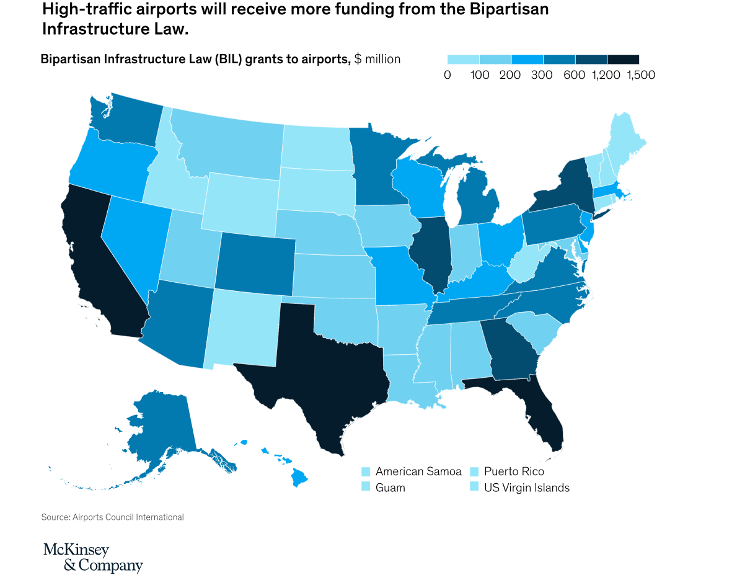

Slide 11
BIL Primary Airport FY 2022 Allocations
Source: FAA website, Bipartisan Infrastructure Law - Airport Infrastructure

Slide 12
BIL GA Airport FY 2022 Allocations
Source: FAA website, Bipartisan Infrastructure Law - Airport Infrastructure

Slide 13
$364 Million for Michigan

Slide 14
Distribution to MI Airports by Category
Source: FAA website, Bipartisan Infrastructure Law - Airport Infrastructure

Slide 15
Primary Airport | FY 2022 Amount
Detroit Metropolitan Wayne County | $33,306,230
Gerald R Ford International | $6,081,477
Bishop International | $2,857,107
Cherry Capital | $2,458,571
Capital Region International | $1,943,441
Kalamazoo/Battle Creek International | $1,672,872
MBS International | $1,566,082
Sawyer International | $1,038,294
Pellston Regional Airport of Emmet County | $1,018,837
Houghton County Memorial | $1,016,181
Chippewa County International | $1,015,815
Ford | $1,014,409
Muskegon County | $1,012,792
Delta County | $1,012,361
Alpena County Regional | $1,008,120
Source: FAA website, Bipartisan Infrastructure Law - Airport Infrastructure

Slide 16
FY 2022 BIL Allocations in MI
Airport Category | FY 2022 Allocation
3 – National* | $763,000
9 - Regional | $295,000
52 - Local | $159,000
14 – Basic | $110,000
Total | $14,752,000
* - Willow Run allocated an additional $52,082 in cargo entitlements.
Source: FAA website, Bipartisan Infrastructure Law - Airport Infrastructure

Slide 17
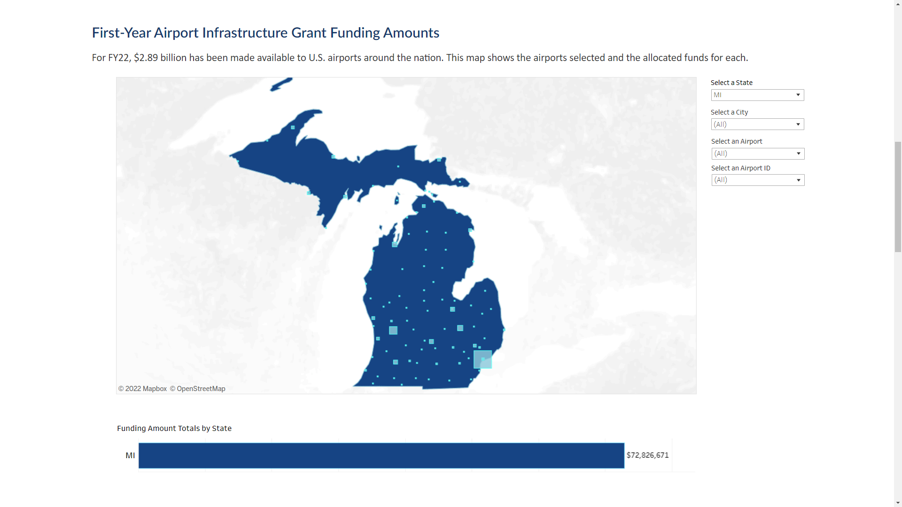

Slide 18
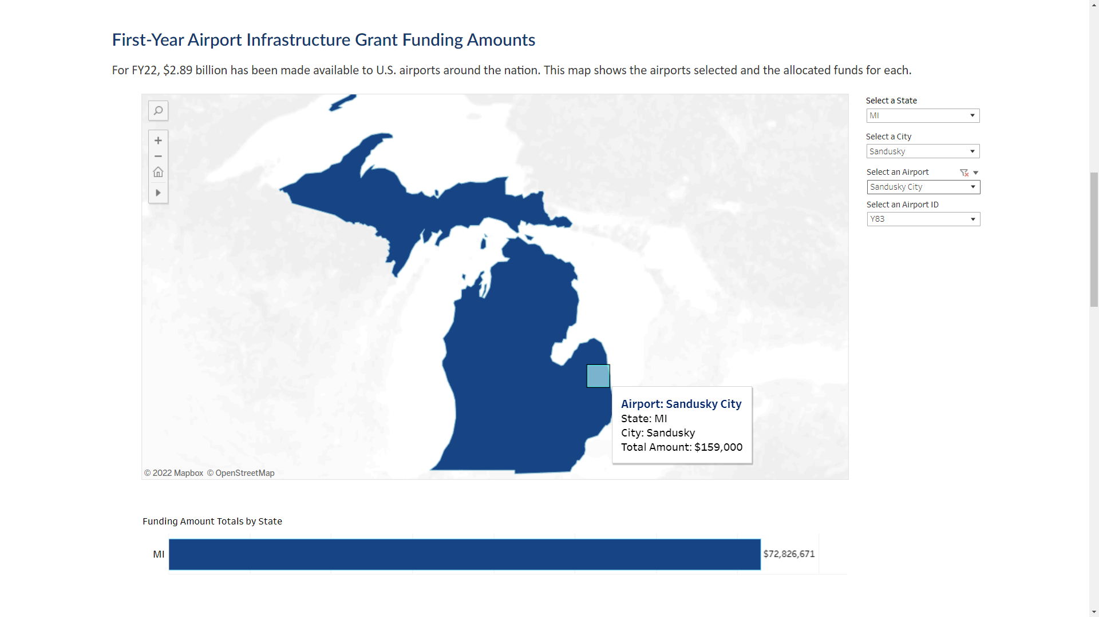

Slide 19
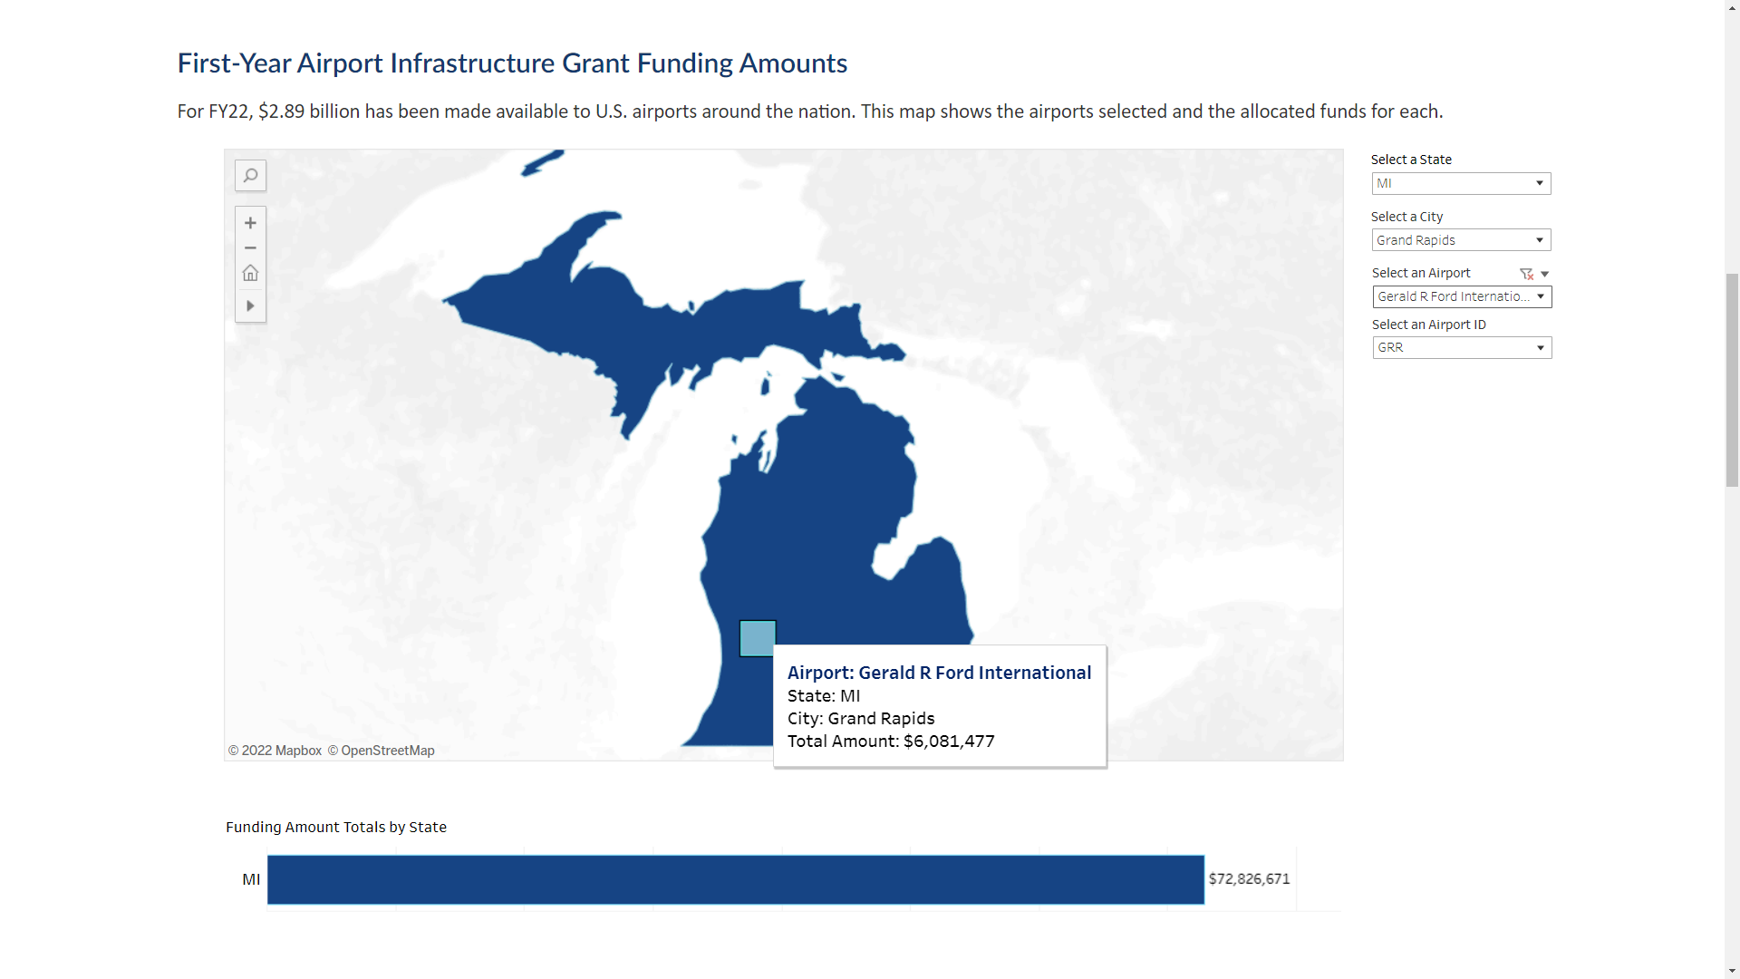

Slide 20
BIL Primary Airport Terminal Allocations
Source: FAA website, Bipartisan Infrastructure Law - Airport Infrastructure

Slide 21
Interactive Poll
Join in on an interactive poll
When poll is active, please join by one of two options:

