Slide 1
Leading Michigan’s Clean Energy Transformation
Brian Lewis
Executive Director of Customer Operations
August XX, 2022

Slide 2
CMS Energy Overview
Corporate Structure
CMS Energy
Consumers Energy
Gas and electric utilities
CMS Enterprises
Unregulated clean energy solutions
CMS Energy Senior Management Team
Garrick Rochow CEO
Rejji Hayes CFO
Shaun Johnson
General Counsel
Cathy Hendrian
People & Culture
DV Rao
Strategy & Planning
LeeRoy Wells
Operations
Brian Rich
Customer Experience & Tech
Tonya Berry
Transformation & Engineering
Brandon Hofmeister
Gov’t & Regulatory Affairs

Slide 3
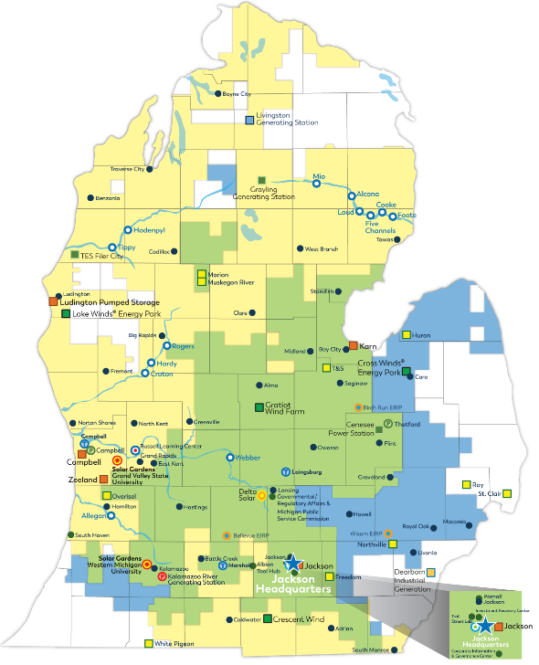
The Michigan Communities We Serve
Consumers Energy has served Michigan customers since 1886
Consumers Energy owns and operates electric generation and distribution facilities and gas transmission, storage, and distribution facilities
1.9 million electric customers
1.8 million gas customers
Notes:
(Source: CMS Energy Form 10-K 0000811156-22-000048 (d18rn0p25nwr6d.cloudfront.net)_
Consumers energy has a strong history of serving the people of Michigan – we have proudly been here since 1886.
We have offices and facilities from Boyne City to South Monroe. My co-workers and I serve millions of customers in nearly every county of Michigan’s lower peninsula.
We are Michiganders through and through, committed to our neighbors in the communities we serve!

Slide 4
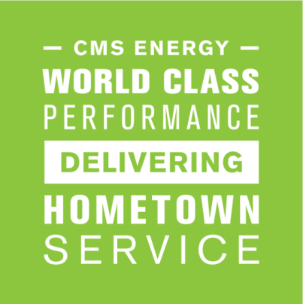
How We Operate
Our Purpose:
The Triple Bottom Line:
People
Planet
Prosperity
Notes:
At Consumers Energy our work is guided by our purpose: World Class Performance Delivering Hometown Service.
We measure the success of our purpose through elements of the triple bottom line: people, planet, and prosperity.

Slide 5
People
9,500 highly trained and skilled co-workers comprise a workforce of union, non‑union and seasonal employees and contractors
First-quartile employee engagement and customer experience
Recognized by Forbes as one of America’s Best Employers and Newsweek as one of America’s Most Responsible Companies
Notes:
Our people make our company special. The team is made up of 9,500 individuals who are highly trained, skilled, and engaged.
I am thankful for a workforce who cares so deeply about our customers, their hearts of service are what ensures we are delivering on our purpose and creating first quartile customer experiences – every time. They are a committed group.
And the company is committed to them. We were recently recognized by Forbes as one of America’s Best Employers and we have received similar accolades from the publication as it relates to women in the workplace and diversity, equity and inclusion.
I am a firm believer in different points of view, and ideas coming together actually make us stronger and help us to deliver on results. Our team has proven that – whether it’s a working mom, military veteran, minority – a person’s individual experiences and knowledge are welcome at Consumers Energy in order to help us better serve Michigan.

Slide 6
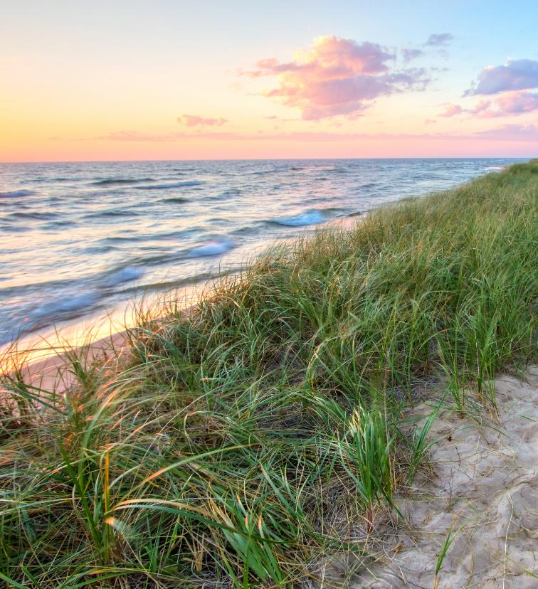
Our Clean Energy Plan
All coal-fired plants will be retired by 2025
By 2040, more than 60% of our electric capacity will come from renewable sources
Net zero carbon emissions by 2040
Grid modernization and battery storage to help lower peak customer demand
Price stability that will save customers $650 million through 2040
Notes:
The final component of how we measure success through the triple bottom line is through the actions we are taking to serve the planet.
Our Clean Energy Plan is industry-leading. Because of it we are seizing a once-in-a-generation opportunity to redefine our company and to help reshape Michigan’s energy future:
Through the work we are committed to:
Supplying cleaner electricity faster and more reliably to our state’s homes and businesses over the next 20 years.
Protecting the environment for generations of Michiganders.
Ensuring affordability in the transition.
It is a solid and well rounded plan, retiring coal, expanding renewables, ensuring net zero carbon emissions, modernizing the grid and utilizing battery storage.
Greg Salisbury, our Vice President of Gas Engineering and Supply, is going to spend the next few minutes going into more details about our commitments to the planet before we open it up to some Q&A.
(Hand it over to Greg, then join Greg for Q&A)

Slide 7
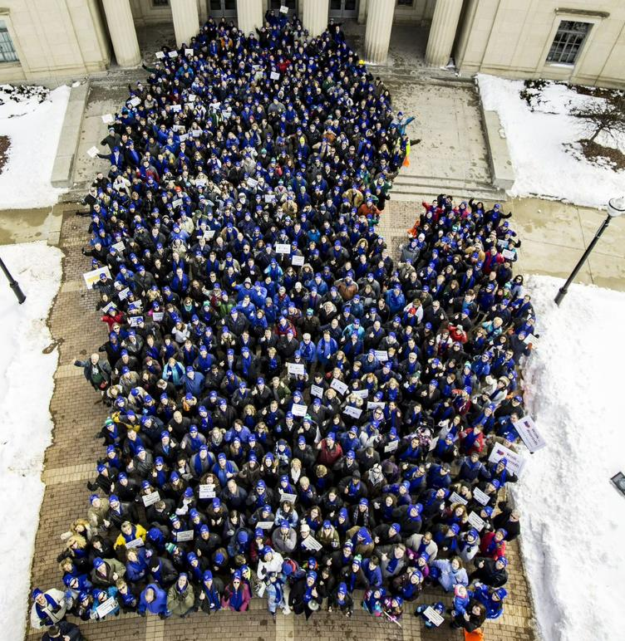
Prosperity
105 MW of new or expanding load – estimated to create 4,000 jobs and bring more than $1 billion of investment to Michigan
Committed to spending $7.5 billion with Michigan-based suppliers as part of the MEDC’s Pure Michigan Business Connect
The Consumers Energy Foundation, Consumers Energy and its co-workers and retirees contributed more than $17.5 million to Michigan nonprofits in 2021
Notes:
Everything we do is with Michigan in mind.
Whether it is expanding new load, partnering with the MEDC to commit to spending with local businesses or through our Foundation work, we want Michigan to prosper.
Let me tell you about a few organizations the Consumers Energy Foundation has focused on in service of prosperity:
Michigan FFA (building talent)
Since 1995, Consumers Energy and the Consumers Energy Foundation have provided more than $450,000 supporting the Michigan FFA through sponsorship of leadership programs, support of the state convention and development of FFA members in leadership
We have had several employees actively involved with the Michigan FFA through the years as board members for the Michigan FFA Foundation and Michigan FFA Association, serving as judges for FFA skills contests at all levels and serving as mentors and supporters of young leaders in agriculture
We proudly join so many other supporters of the Michigan FFA – Michigan Farm Bureau, AgroLiquid, Greenstone Farm Credit Services and so many others
Michigan Centennial Farm Program (honoring farms)
For decades the company has supported the Michigan Centennial Farm program
We are honored to work with the Historical Society of Michigan since 2008 to recognize farms that have remained in the same family for 100 years or more
In 2021 alone, 125 farms were recognized with this distinction within Consumers Energy’s service territory (includes 100 yr recognition and 125 yr recognition)
Michigan Farm Bureau (supporting ag education)
Our foundation provided $50,000 to support the Michigan Foundation for Agriculture and the first FARM Science lab. (Mobile Food Agriculture & Resources in Motion – science lab on wheels teaching kids about agriculture)

Slide 8
What is the Clean Energy Plan?
Eliminate coal by 2025
More renewable energy
More customer control
Net zero emissions
A smarter grid
Flexible strategy
Notes:
We recently updated our 20-year strategic road map to protect Michigan’s environment.
The Clean Energy Plan is a sea change that will transform our operations and create a brighter energy future for Michigan. Accelerating the end of coal use to 2025, dramatically boosting the contribution of solar energy and using natural gas as a bridge fuel will help us meet the state’s energy needs reliably while protecting the environment for generations to come.

Slide 9
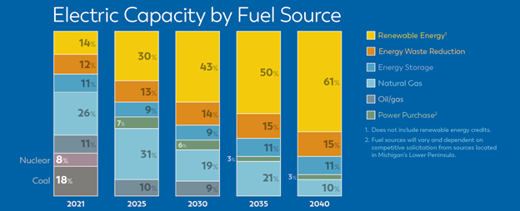
The Path Forward
By 2025: 30% renewables and 31% natural gas
By 2040: 61% renewables and 10% natural gas
Notes:
Accelerating the end of coal use to 2025, dramatically boosting the contribution of solar energy and using natural gas as a bridge fuel will help us meet the state’s energy needs reliably while protecting the environment for generations to come.
By 2040, clean, renewable fuel sources such as solar and wind will comprise more than 60 percent of our electric capacity.
Combining that growth with advances in energy storage and customer efficiency will allow us to meet customers needs with 90 percent clean energy resources.

Slide 10
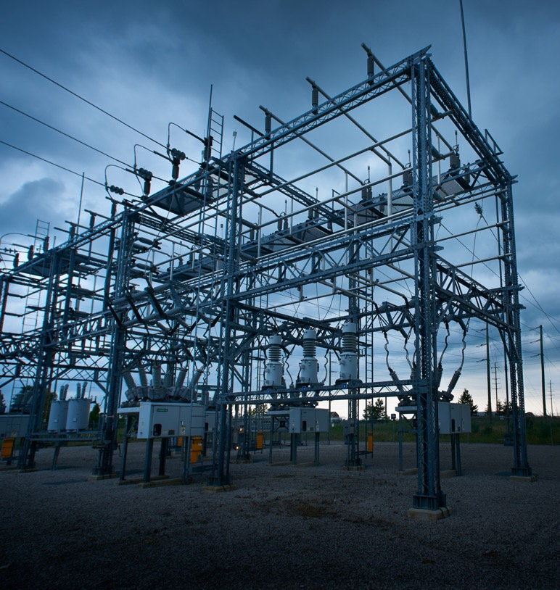
A Smarter Grid
Energy efficiency, demand response and emerging technologies such as grid modernization and battery storage will help us lower peak customer demand for electricity and deliver exactly what Michigan needs.
Notes:
Energy efficiency and demand response will continue to play significant roles in our generation portfolio as we retire coal plants. These virtual “power plants” will help us reduce energy demand and manage customer load efficiently and effectively.
We plan to ramp up demand response programs, which provide a system of rewards for customers to use energy at the right times. These programs will significantly lower our overall need to build new power plants over the next several years.
And we plan to make the grid more energy efficient, lowering Michigan’s overall need for power plants.
By 2040, customer efficiency programs and battery storage would account for nearly 30 percent of our electric capacity.

Slide 11
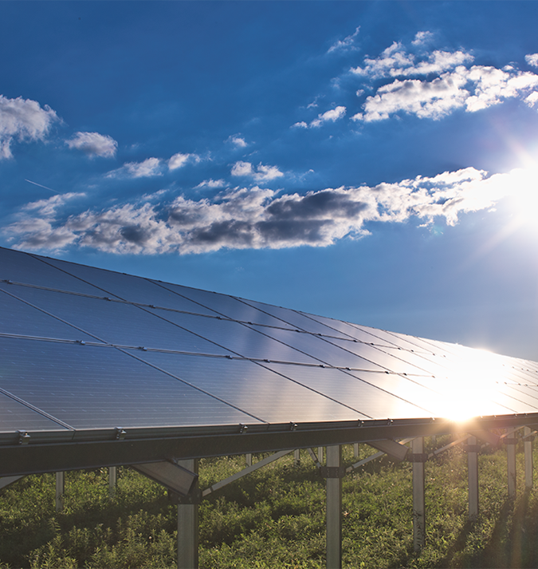
More Renewable Energy
We plan to meet 90 percent of your energy needs with clean resources, including the addition of nearly 8,000 megawatts of solar power.
Notes:
Tapping clean, renewable fuel sources for electricity — especially solar power — is the key to building a brighter energy future for Michigan. That’s why our plan dramatically expands the amount of renewable energy we’ll supply to customers in the coming decades.
Our plan forecasts renewable energy capacity levels of:
35 percent by 2025
47 percent by 2030
63 percent by 2040
The rapid transition to clean, renewable sources includes the addition of 7,800 megawatts of solar power. Our solar ramp-up has started and will continue throughout the 2020s.

Slide 12
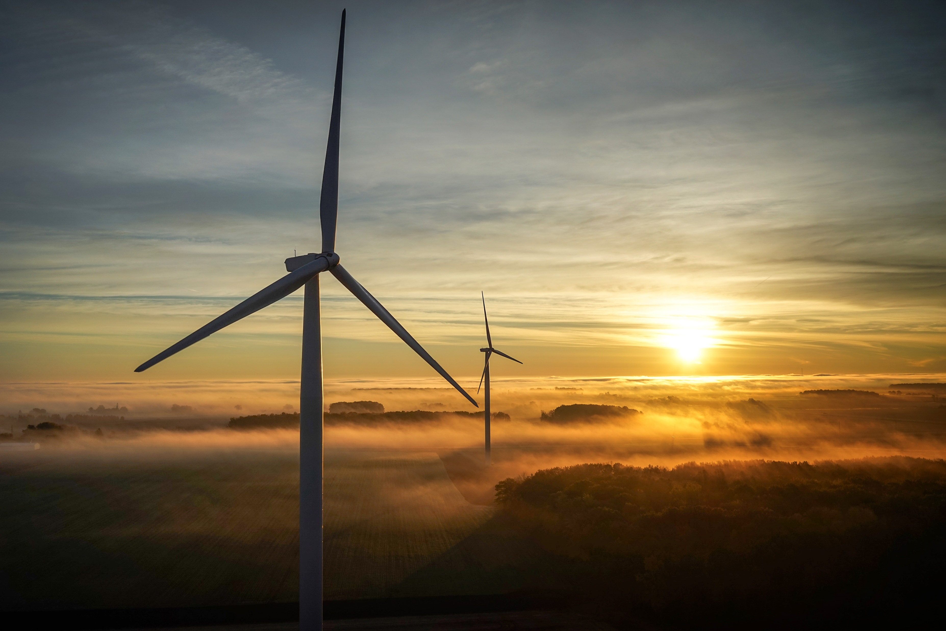
Renewable Energy Options
Subscribe to have renewable, Michigan-made energy power your business. Meet your sustainability goals and accelerate decarbonization of Michigan’s electric grid.
What it is: Match your facility's electric use with renewable energy generated by a Consumers Energy owned and operated Michigan resources.
Why it’s valuable: Hassel-free renewable energy solution: no upfront costs, flexible contracting and turnkey.
Notes:
AN AFFORDABLE WAY TO DRIVE CLEAN ENERGY
No upfront costs
Advance the development of renewable energy without the upfront costs and long-term maintenance of owning your own renewable energy system.
Cost effective rates
You’ll match your energy use with zero-carbon energy generated from wind or solar resources at a fixed subscription rate. That rate is based on a percentage of your company’s overall energy use. (The historical net premium is -$0.01/kWh.) You can even receive energy and capacity credits back on your bill, depending on market pricing for the energy generated, which can be used to offset the cost of your premium.
MEET YOUR SUSTAINABILITY GOALS WITHOUT IMPACTING YOUR BUSINESS
Hassle-Free
We will validate your renewable energy investment with zero paperwork. Renewable Energy Credits (RECs) will be retired on your behalf, and we’ll provide the documentation you need to support your carbon accounting standards.
Flexible
Make a commitment for a minimum of 10 years or up to 20 years, depending on your sustainability goals. Enroll in 5% increments from 20% up to 100% of your annual energy use. Since the contract is based on that percentage, you will not see any penalty with any rise or fall of your energy use — the contract will move with your business.
Turnkey
Make a difference without making an impact on your operations. No turbines or solar arrays need to be constructed on your property. Plus there’s no need to modify your existing electric infrastructure, leaving your business untouched.
MAKE A DIFFERENCE TO MICHIGAN
Customer-driven
Offset your carbon footprint by bringing new renewable energy resources to Michigan, helping our energy system become cleaner, faster.
Michigan-based
Program participation gives your company the ability to showcase specific wind or solar resources in Michigan as you meet your sustainability goals — so you can demonstrate your commitment to our communities and economy as your join decarbonization efforts.

Slide 13
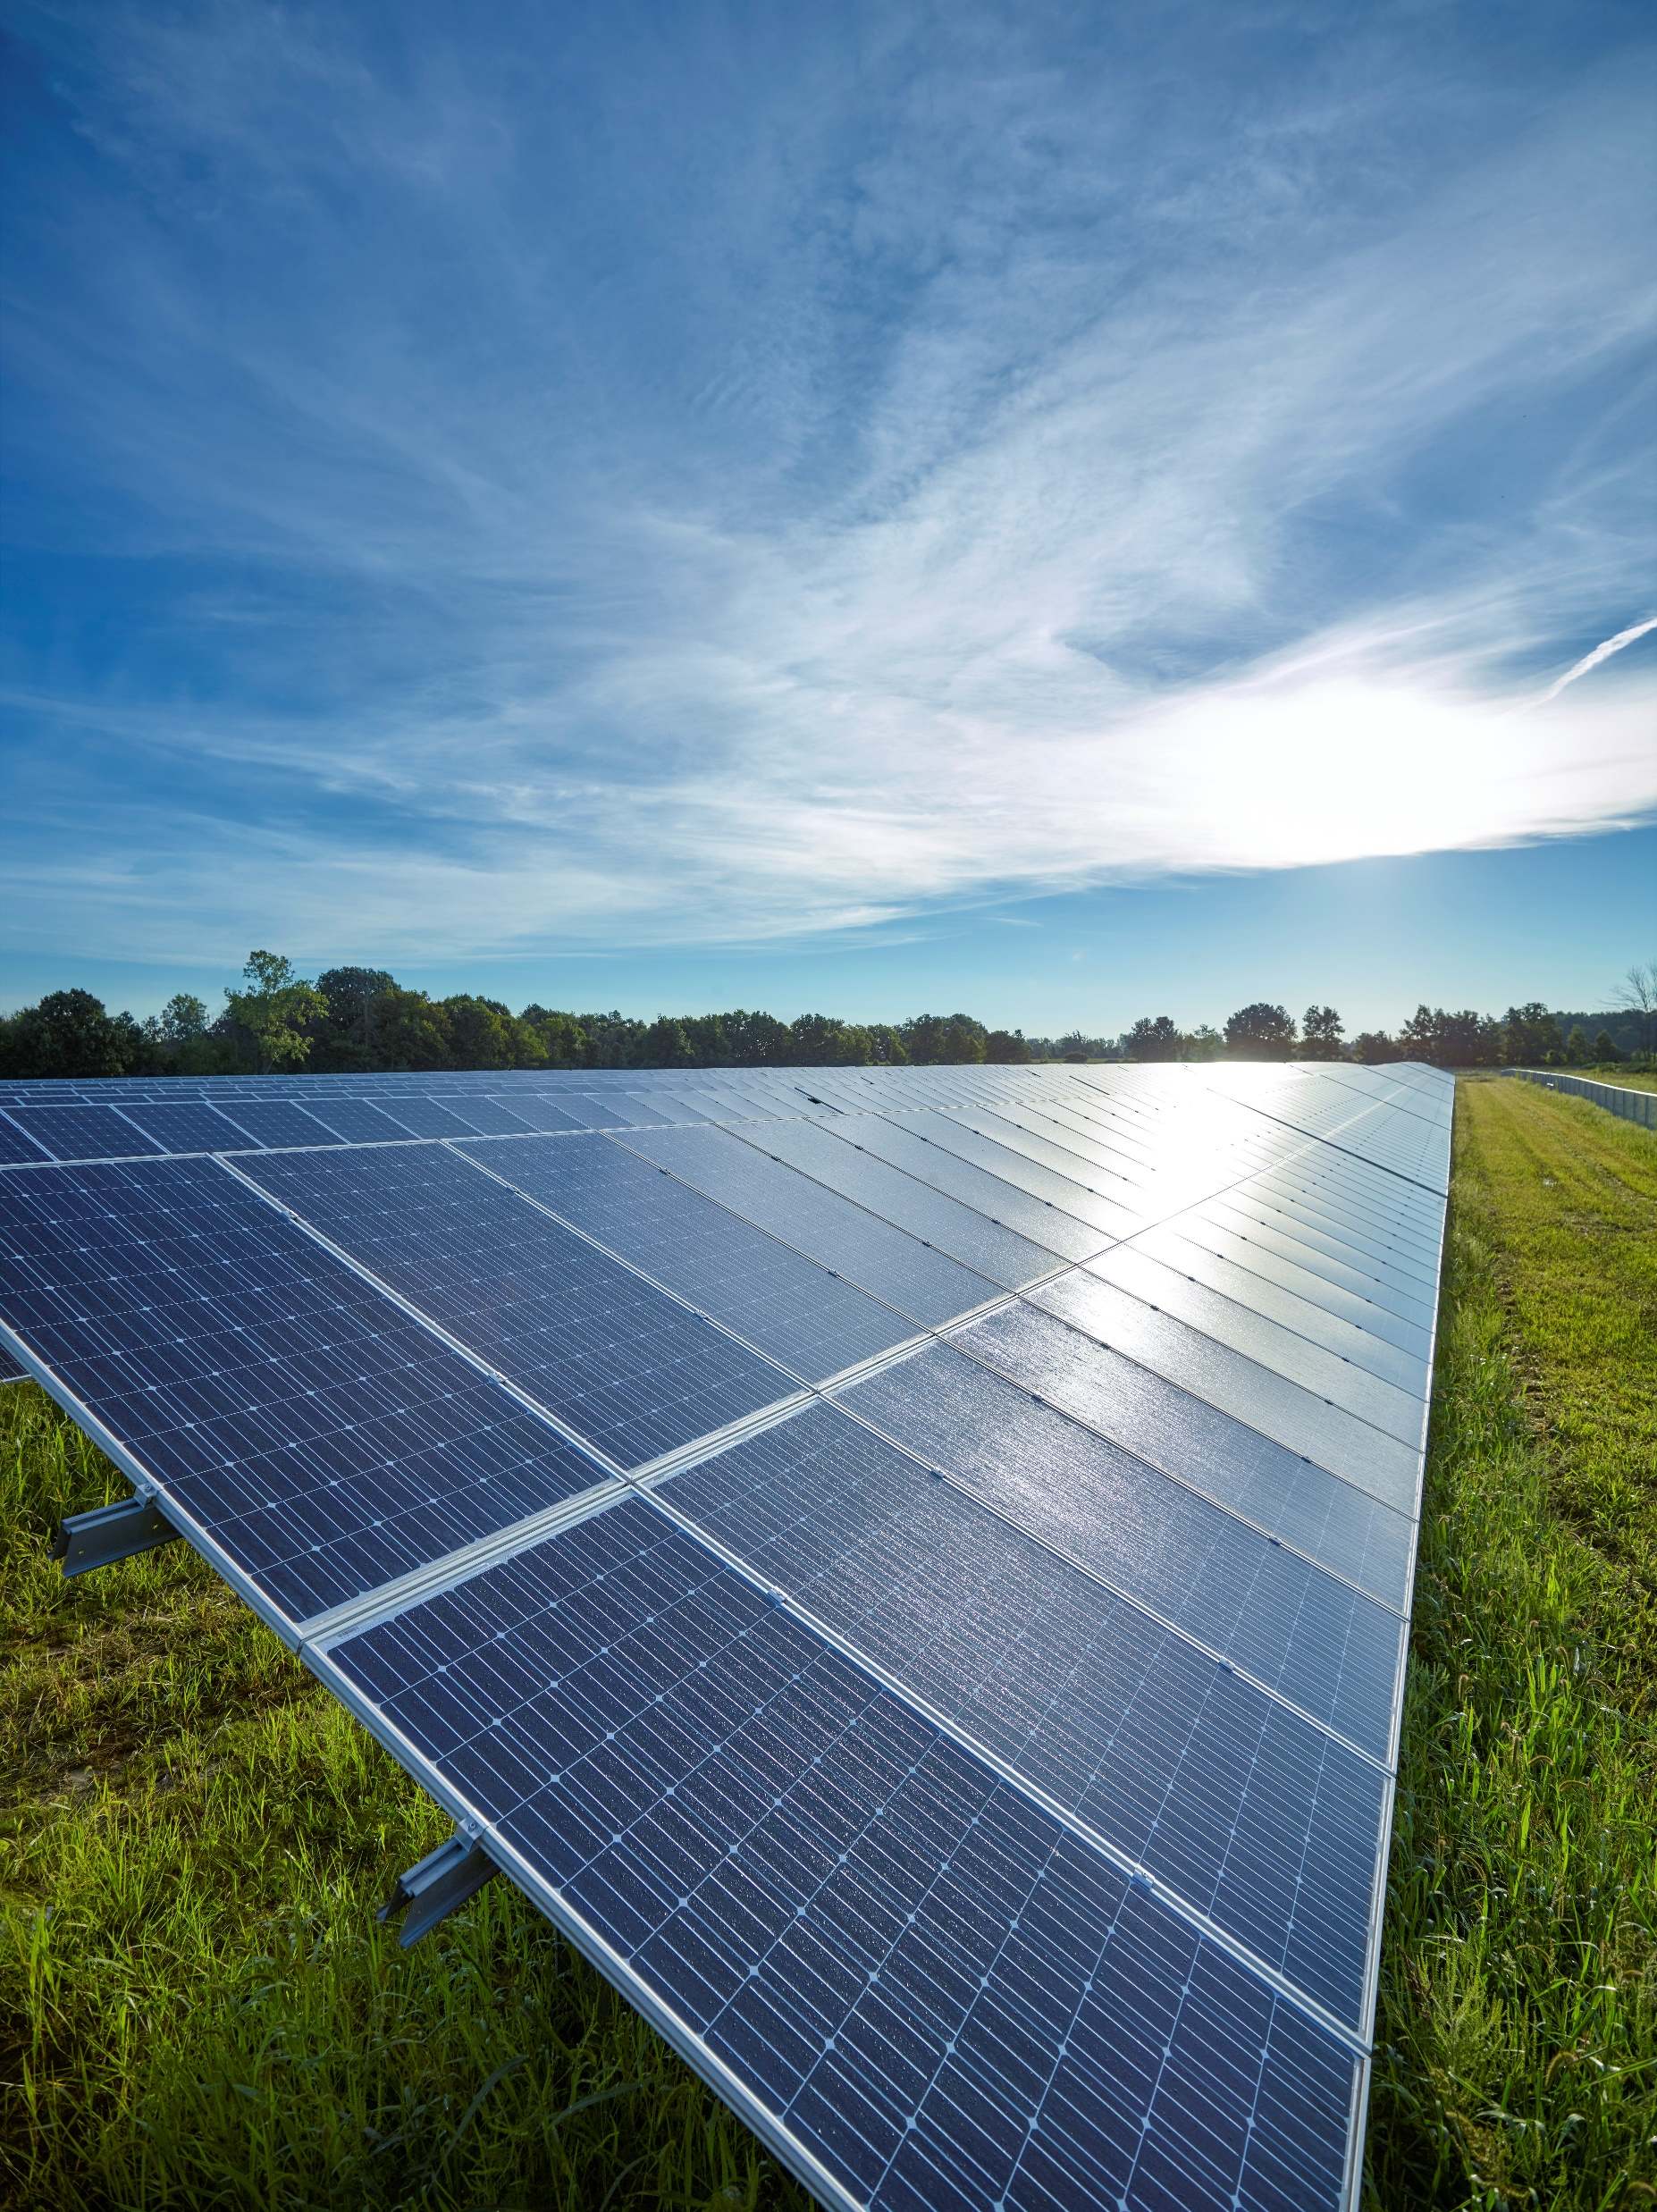
Solar Gardens
Partner with Consumers Energy to bring zero-carbon, solar generation to your local community.
What it is: With available land, you can become an Anchor Tenant and subscribe to 100% Michigan-Made Solar Energy. CE will own, operate and maintain the solar facility.
Why it’s valuable: You promote a cleaner energy landscape in your community without the upfront costs and long-term maintenance plus receive a credit for solar energy produced in return for a small fee on your monthly energy bill.

Slide 14
Trusted Energy Management and Sustainability Solutions
Energy Management & Waste Reduction
Renewable Energy Programs
Demand Response
Our energy experts can help you improve your operations and bottom line by reducing energy waste.
We offer several programs that can be tailored to meet your sustainability goals.
When you use energy is just as important as how much you use. We have programs that can offer energy insights and help you save money.
Notes:
You can improve operational efficiencies by reducing energy waste, optimizing energy rates and meeting your sustainability goals through a variety of programs. We’re here to help with all of it.
Our energy experts will work with you to understand your goals, operations and long-term plans to create an integrated solution that balances operational efficiencies with clean, renewable energy.
You can count on us to help you save on energy costs and meet your sustainability needs for the years to come.

Slide 15
Demand Response
What it is: Earn incentives and bill credits for agreeing to reduce energy use when demand on the grid is at it's greatest. DR customers earn an average of $11,500 a year.
Why it’s valuable: Enrolling in our Demand Response program is a small but impactful change that can help keep your community’s and state’s energy reliable, affordable and help to increase your businesses bottom line
Notes:
Business Demand Response
Commit to summertime load reductions when notified in advance in June through September.
Take advantage of standby generators when savings are significant.
Advance Event Notification
30 minute notice -12 hour
precautionary email
Payment
$25/kW-paid at end of MISO season on your bill (Nov 2021)
Curtailment 750kW = $18,900
If you could not curtail all 750kW, you could curtail 105kW and still be money ahead.

Slide 16
Energy Waste Reduction
What it is:
Rebates available for more than 425 energy efficient products and services
Rebates offset incremental project costs 25%-35%, on average
Energy Advisors can help you find the best opportunities to save energy
Energy engineers are available to evaluate your energy savings potential
Why it’s valuable:
You can receive rebates of up to 75% of total project costs - up to $2M annually*
*terms and conditions apply
Notes:
Business Energy Waste Reduction:
What is it?
Important component of the Company’s Clean Energy Plan.
For us, it’s helping you get the most value out of the energy we provide to you.
Since 2009, more than 46,000 businesses have received an incentive for their participation.
Why it’s valuable?
Since 2009, businesses have received over $250 million incentives with on-bill business customer savings of $1.3 billion.
The cheapest kWh is the one not used.
We can talk more about Energy Waste Reduction anytime.

Slide 17
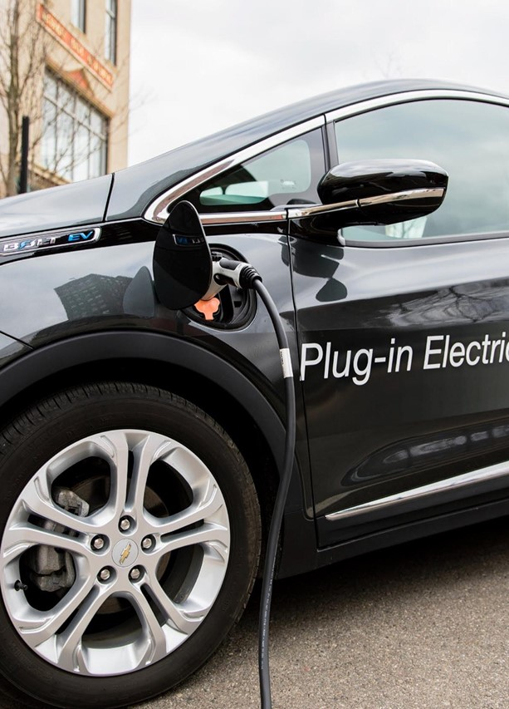
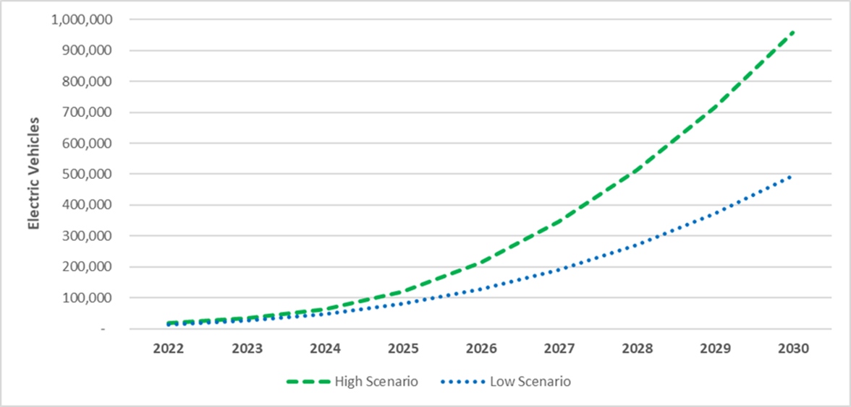
Notes:
Photo is the Meijer East Lansing DCFC site which received a $70K rebate from the first round of PowerMIDrive.

Slide 18
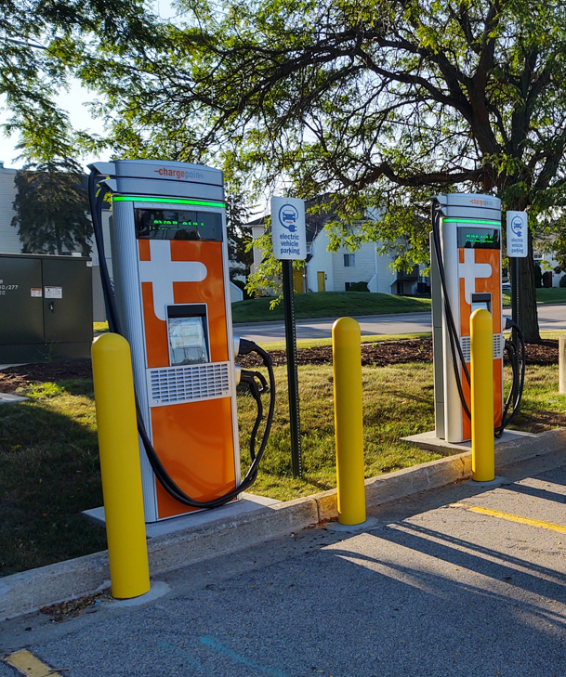
Consumers Energy $70K rebate for 150 kW DCFC site plus make ready funding
Applicants are coordinated with EGLE for potential federal infrastructure funds (requires 4 x 150 kW DCFCs)
Required installation timeline: June 2022-June 2024.
Notes:
Photo is the Meijer East Lansing DCFC site which received a $70K rebate from the first round of PowerMIDrive.

Slide 19
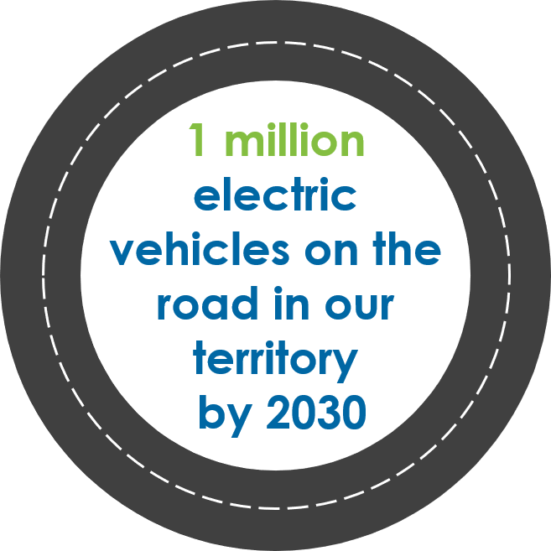
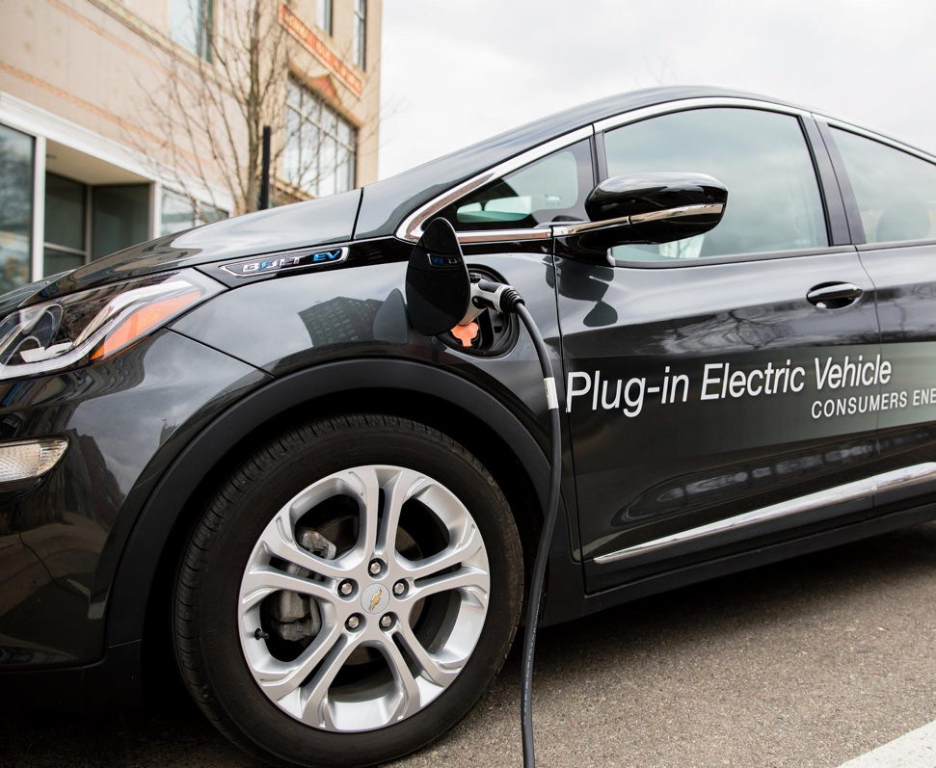
Our 2030 EV Goal
We are committed to being an EV catalyst
Most bearish forecasts estimated 200,000 EVs for our territory in 2030
EVs in our territory today = 15,000 EVs
1 million EVs in 2030 would be 33% of vehicles on the road

Slide 20
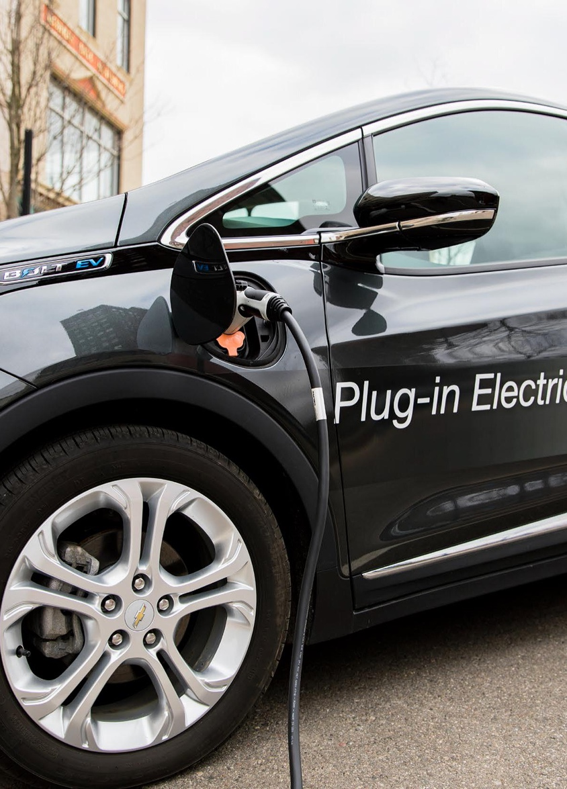
Education & Outreach / Concierge Service
Consultants analyze & create report:
Identify vehicles best suited for electrification per duty cycle
Best locations for charging infrastructure
Cost benefit analysis of electrification
Rebates for fleet charging infrastructure
$5,000 rebate per dual port Level 2 (up to 500 rebates in total and 10 per site)
$35,000-$70,000 per DCFC ($500,000 limit; 7-14 rebates in total)
$1.6M earmarked for income-qualified fleets
Make Ready (new power/electric infrastructure upgrades)
Technical Development
Workplace demand response
Bi-directional power flow demonstration - Dependent on market/customer readiness

Slide 21
Questions?

Slide 22
ConsumersEnergy.com/change

